Slide 1


Dept. of Computer Science & Engineering.
Assignment 1
HTML Tags and Forms
PLD
Prepared By
Prof. A. R. Uttarkar and WTL subject incharges
Assistant Professor
CSE Department, MIT SOE

Slide 2
What is HTML?
HTML is the standard markup language for creating Web pages.
HTML stands for Hyper Text Markup Language
HTML describes the structure of Web pages using markup
HTML elements are the building blocks of HTML pages
HTML elements are represented by tags
Browsers do not display the HTML tags, but use them to render the content of the page

Slide 3
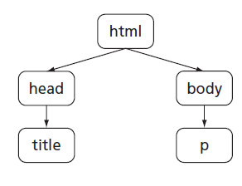
HTML – Hyper Text Markup Language
It describes the structure of Web pages using markup.
HTML elements are represented by tags and are the building blocks of HTML pages.
Browsers do not display the HTML tags, but use them to render the content of the page
<!DOCTYPE html> declaration
defines this document to be HTML5
not case sensitive
helps browsers to display web pages correctly
<html> element is the root element.
<head> element contains meta information.
Metadata typically define the document title, character set, styles, links, scripts, and other meta information.
<meta charset="UTF-8">
UTF stands for Unicode Transformation Format. The '8' means it uses 8-bit blocks to represent a character

Slide 4
HTML – Hyper Text Markup Language
Nested HTML elements
Empty HTML elements
elements with no content (<br>
To make document readable by XML parsers; all elements must be closed.
Tags are not case sensitive (<P> and <p> are same)
HTML Attributes
All HTML elements can have attributes
Attributes provide additional information about an element
Attributes are always specified in the start tag
Attributes usually come in name/value pairs like: name="value"
<img src="img_test.jpg" width="500" height="600">
<img src="img_test.jpg" alt=“World Health Day">
<p style="color:red">I am a paragraph</p>

Slide 5

HTML – Hyper Text Markup Language
HTML Headings - <h1> to <h6>
<h1 style="font-size:60px;">Heading 1</h1>
Style attribute
<tagname style="property:value;">
The property is a CSS property. The value is a CSS value.
Tables, links, forms
Formatting elements
b, strong, i, em, mark, small, del, ins, sub, sup,
HTML Quotations
<q>, <blockquote>, <abbr>, <address>
<p>The <abbr title="World Health Organization">WHO</abbr> was founded in 1948.</p>

Slide 6
A Simple HTML Document
Example
Explanation
<html> <head> <title>Page Title</title> </head> <body> <h1>My First Heading</h1> <p>My first paragraph.</p> </body> </html>
The <html> element is the root element of an HTML page
The <head> element contains meta information about the document
The <title> element specifies a title for the document
The <body> element contains the visible page content
The <h1> element defines a large heading
The <p> element defines a paragraph

Slide 7
HTML Tags
HTML tags are element names surrounded by angle brackets:
<tagname>content goes here...</tagname>
HTML tags normally come in pairs like <p> and </p>
The first tag in a pair is the start tag, the second tag is the end tag
The end tag is written like the start tag, but with a forward slash inserted before the tag name

Slide 8
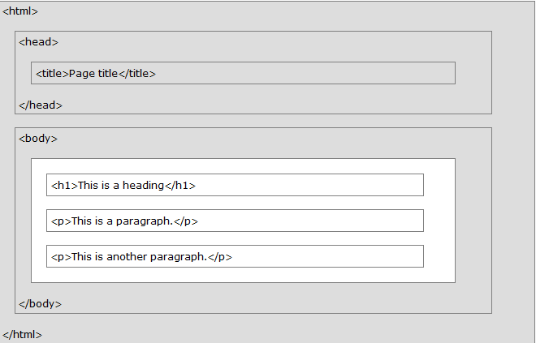
HTML Page Structure

Slide 9
Creating HTML Page
Write HTML Using Notepad or TextEdit
Save the file on your computer using .html or .htm extension and set the encoding to UTF-8
View the HTML Page in Your Browser

Slide 10
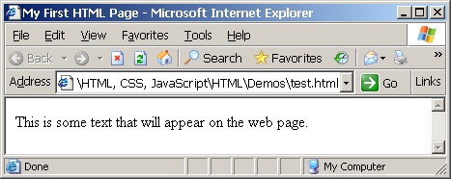
First HTML Page
test.html
<!DOCTYPE HTML>
<html>
<head>
<title>My First HTML Page</title>
</head>
<body>
<p>This is some text...</p>
</body>
</html>

Slide 11
Headings and Paragraphs
Heading Tags (h1 – h6)
Paragraph Tags
<h1>Heading 1</h1>
<h2>Sub heading 2</h2>
<h3>Sub heading 3</h3>
<p>This is my first paragraph</p>
<p>This is my second paragraph</p>

Slide 12
Text Formatting
Text formatting tags modify the text between the opening tag and the closing tag
Ex. <b>Hello</b> makes “Hello” bold
<b></b> | bold
<i></i> | italicized
<u></u> | underlined
<sup></sup> | Sample^{superscript}
<sub></sub> | Sample_{subscript}
<strong></strong> | strong
<em></em> | emphasized
<pre></pre> | Preformatted text
<blockquote></blockquote> | Quoted text block
<del></del> | Deleted text – strike through
‹#›

Slide 13
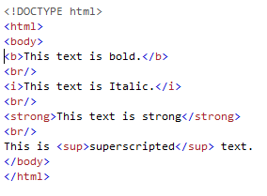

Text Formatting Example
HTML Code
Output

Slide 14
Hyperlinks: <a> Tag
Link to a document called form.html on the same server in the same directory:
<a href="form.html">Fill Our Form</a>

Slide 15
Links to the Same Document – Example
links-to-same-document.html
<h1>Table of Contents</h1>
<p><a href="#section1">Introduction</a><br />
<a href="#section2">Some background</A><br />
<a href="#section2.1">Project History</a><br />
...the rest of the table of contents...
<!-- The document text follows here -->
<h2 id="section1">Introduction</h2>
... Section 1 follows here ...
<h2 id="section2">Some background</h2>
... Section 2 follows here ...
<h3 id="section2.1">Project History</h3>
... Section 2.1 follows here ...

Slide 16
Images: <img> tag
Inserting an image with <img> tag:
Image attributes:
Example:
<img src="/img/basd-logo.png">
src | Location of image file (relative or absolute)
alt | Substitute text for display (e.g. in text mode)
height | Number of pixels of the height
width | Number of pixels of the width
border | Size of border, 0 for no border
<img src="./php.png" alt="PHP Logo" />
‹#›

Slide 17
Ordered Lists: <ol> Tag
Create an Ordered List using <ol></ol>:
Attribute values for type are 1, A, a, I, or i
<ol type="1" >
<li>Apple</li>
<li>Orange</li>
<li>Grapefruit</li>
</ol>
Apple
Orange
Grapefruit
Apple
Orange
Grapefruit
Apple
Orange
Grapefruit
Apple
Orange
Grapefruit
Apple
Orange
Grapefruit

Slide 18
Unordered Lists: <ul> Tag
Create an Unordered List using <ul></ul>:
Attribute values for type are:
disc, circle or square
<ul type="disk" >
<li>Apple</li>
<li>Orange</li>
<li>Grapefruit</li>
</ul>
Apple
Orange
Pear
Apple
Orange
Pear
Apple
Orange
Pear

Slide 19
Definition lists: <dl> tag
Create definition lists using <dl>
Pairs of text and associated definition; text is in <dt> tag, definition in <dd> tag
Renders without bullets
Definition is indented
<dl>
<dt>HTML</dt>
<dd>A markup language …</dd>
<dt>CSS</dt>
<dd>Language used to …</dd>
</dl>

Slide 20
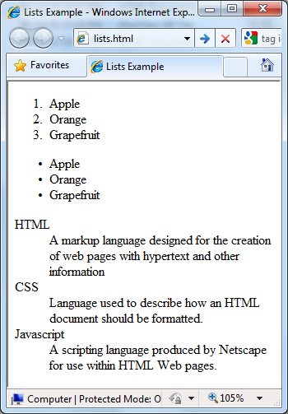
Lists – Example
lists.html
<ol type="1">
<li>Apple</li>
<li>Orange</li>
<li>Grapefruit</li>
</ol>
<ul type="disc">
<li>Apple</li>
<li>Orange</li>
<li>Grapefruit</li>
</ul>
<dl>
<dt>HTML</dt>
<dd>A markup lang…</dd>
</dl>

Slide 21
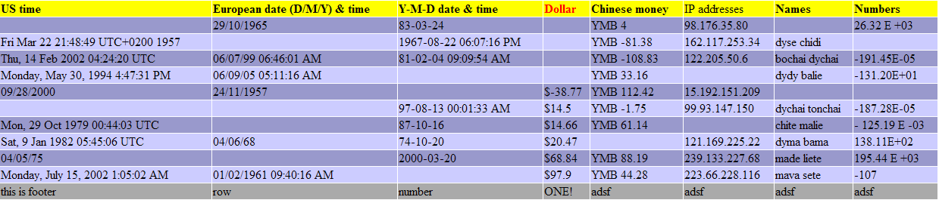
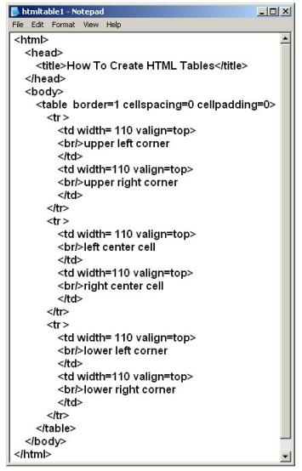
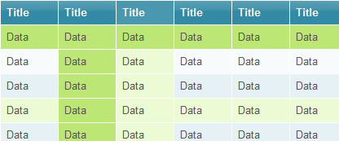
HTML Tables

Slide 22
HTML Table Tags
Tag | Description
<table> | Defines a table
<th> | Defines a header cell in a table
<tr> | Defines a row in a table
<td> | Defines a cell in a table
<caption> | Defines a table caption
<colgroup> | Specifies a group of one or more columns in a table for formatting
<col> | Specifies column properties for each column within a <colgroup> element
<thead> | Groups the header content in a table
<tbody> | Groups the body content in a table
<tfoot> | Groups the footer content in a table

Slide 23
HTML Tables (2)
Start and end of a table
Start and end of a row
Start and end of a cell in a row
<table> ... </table>
<tr> ... </tr>
<td> ... </td>

Slide 24

Simple HTML Tables – Example
<html>
<body>
<table width=100% border = "1" bgcolor = "yellow"> <tr> <th>Firstname</th> <th>Lastname</th> <th>Age</th> </tr> <tr> <td>Jill</td> <td>Smith</td> <td>50</td> </tr> </table>
</body>
</html>

Slide 25

Simple HTML Tables – Example
<html>
<body>
<table width=50% border = "1" > <tr> <th colspan=2>Firstname</th> <th>Age</th> </tr> <tr> <td>Jill</td> <td>Smith</td> <td>50</td> </tr> </table>
</body>
</html>

Slide 26
HTML Tables – colspan Example
<html>
<body>
<table width=50% border = "1" > <tr> <th colspan=2>Firstname</th> <th>Age</th> </tr> <tr> <td>Jill</td> <td>Smith</td> <td>50</td> </tr> </table>
</body>
</html>

Slide 27
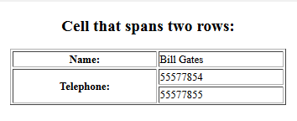
HTML Tables – rowspan Example
<h2 align=center> Cell that spans two rows: </h2>
<table style="width:50%“ border=“1” align=center>
<tr>
<th>Name:</th>
<td>Bill Gates</td>
</tr>
<tr>
<th rowspan="2">Telephone:</th>
<td>55577854</td>
</tr>
<tr>
<td>55577855</td>
</tr>
</table>
</body>
</html>

Slide 28
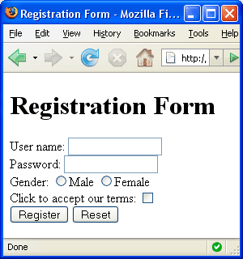


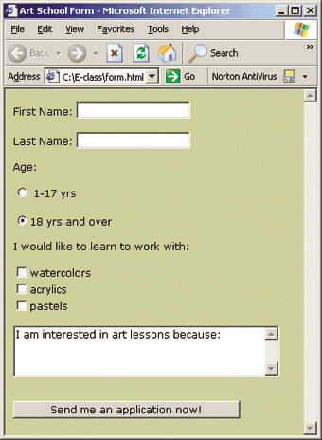
HTML Forms
Entering User Data from a Web Page

Slide 29
HTML Form
The <form> Element
The HTML <form> element defines a form that is used to collect user input:
Syntax
<form> form elements </form>
Form elements are different types of input elements, like
text fields, checkboxes, radio buttons, submit buttons
password, email, search, tel, date, color, file

Slide 30
The <input> Element
HTML5 Input Types
HTML5 added several new input types
color
date
datetime-local
email
month
number
range
search
tel
time
url
week
The <input> element is the most important form element.
Here are some examples:
Input Type Text
Input Type Password
Input Type Submit
Input Type Radio
Input Type Reset
Input Type Checkbox
Input Type Button …etc

Slide 31
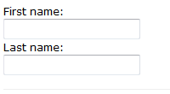
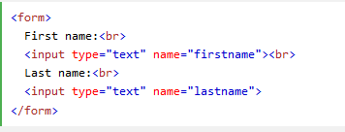
Input Type Text
<input type="text"> defines a one-line text input field:
Example
This is how the HTML code above will be displayed in a browser:
<input type=”text” pattern=”[A-Za-z]{3}”>

Slide 32
Input type=text/email/url/tel
<input type="text" value="CSE" readonly> <br>

Slide 33
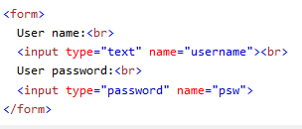
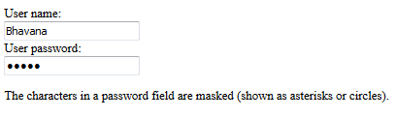
Input Type Password
<input type="password">
defines a password field:
Example
This is how the HTML code above will be displayed in a browser:

Slide 34
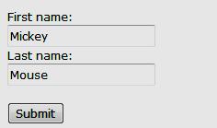
Input Type Submit
defines a button for submitting form data to a form-handler.
The form-handler is specified in the form's action attribute:
Example
<form action="/action_page.php"> First name:<br> <input type="text" name="firstname" value="Mickey"> <br> Last name:<br> <input type="text" name="lastname" value="Mouse"><br><br> <input type="submit" value="Submit"> </form>

Slide 35
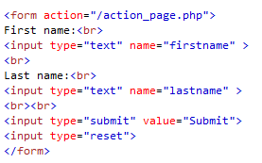
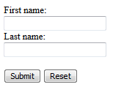
Input Type Reset
<input type="reset"> defines a reset button that will reset all form values to their default values:
click the "Reset" button, the form-data will be reset.
Example

Slide 36

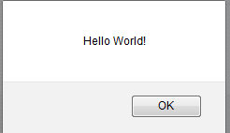
Input Type Button
<input type="button"> defines a button:
Example
<input type="button" onclick="alert('Hello World!')" value="Click Me!">
After clicking above button it shows output as below:

Slide 37

Input Type Radio
<input type="radio"> defines a radio button.
Radio buttons let a user select ONLY ONE of a limited number of choices:
<form> <input type="radio" name="gender" value="male" checked> Male<br> <input type="radio" name="gender" value="female"> Female<br> <input type="radio" name="gender" value="other"> Other </form>
This is how the HTML code above will be displayed in a browser:

Slide 38

Input Type Checkbox
<input type="checkbox"> defines a checkbox.
Checkboxes let a user select ZERO or MORE options of a limited number of choices.
Example
<form> <input type="checkbox" name="vehicle1" value="Bike"> I have a bike
<br> <input type="checkbox" name="vehicle2" value="Car"> I have a car </form>
This is how the HTML code above will be displayed in a browser:

Slide 39
HTML Input Attributes
The value Attribute
The readonly Attribute
The disabled Attribute
The size Attribute
The maxlength Attribute

Slide 40

The <select> Element (Dropdown menus)
The <select> element defines a drop-down list:
<select name="cars"> <option value="volvo">Volvo</option> <option value="saab">Saab</option> <option value="fiat">Fiat</option> <option value="audi">Audi</option> </select>

Slide 41

The <select> Element with multiple selection
<select name="cars" size="4" multiple> <option value="volvo">Volvo</option> <option value="saab">Saab</option> <option value="fiat">Fiat</option> <option value="audi">Audi</option> </select>

Slide 42
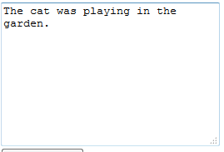
The <textarea> Element
<textarea name="message" rows="10" cols="30"> The cat was playing in the garden. </textarea>
The rows attribute specifies the visible number of lines in a text area.
The cols attribute specifies the visible width of a text area.

Slide 43
HTML Forms – Example
<html><body>
<form>
<h1 align = Center style=“color:blue”> Admission Enquiry Form</h1>
<hr>
<table align =center border=1 bgcolor=lightyellow>
<tr><td>Name</td>
<td> <input type="text"></td></tr>
<tr><td>Address</td>
<td> <input type="text" value="Nashik"></td></tr>
<tr><td>Mobile Number</td>
<td> <input type="text" maxlength=10></td></tr>
<tr><td>DOB </td>
<td><input type="date"></td></tr>
<tr><td>Email-id</td>
<td> <input type="email"></td></tr>

Slide 44
HTML Forms – Example
<tr><td>Gender</td><td>
<input type="radio"> Male
<input type="radio"> Female
<input type="radio"> Other
</td></tr>
<tr><td>Hobbies</td><td>
<input type="checkbox"> Programming<br>
<input type="checkbox"> Construction<br>
<input type="checkbox"> Designning</td></tr>
<tr><td> Select Branch</td><td>
<select size=3 multiple>
<option> Computer </option>
<option> Civil </option>
<option> E & Tc </option>
<option> Mechanical </option></select></tr>

Slide 45
HTML Forms – Example
<tr><td>Rate this Site</td>
<td> <input type="number" value=5 Min="1" Max="5"></td></tr>
<tr><td>Comments </td>
<td> <textarea cols="30" rows="4">Give Your Comments Here /textarea> </td></tr>
<tr><td colspan=2 align=center><input type=submit style="font-size:16px" > <input type=reset style="font-size:16px"></td></tr>
</table>
</form>
</body>

Slide 46
Fieldset and legend
The <fieldset> tag is used to group related elements in a form.
The <fieldset> tag draws a box around the related elements.
<fieldset>
<legend>What is your favorite color?</legend>
<input type="checkbox" name="favcolor"
value="blue" id="blue">
<label for="blue">blue</label><br>
<input type="checkbox" name="favcolor" value="red"
id="red" checked>
<label for="red">red</label><br>
</fieldset>
The <legend> tag is used to define a caption for the <fieldset> element.

Slide 47
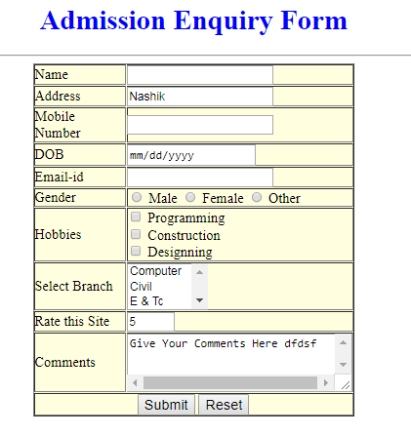
HTML Forms – Example Output

Slide 48
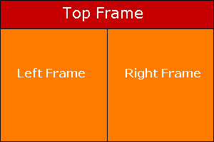
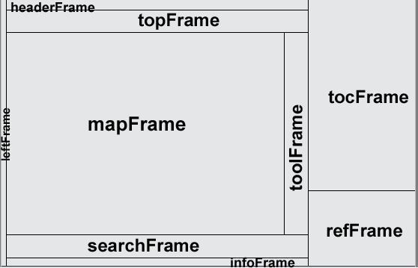
HTML Frames
<frameset>, <frame> and <iframe>

Slide 49
HTML Frames
Frames provide a way to show multiple HTML documents in a single Web page
The page can be split into separate views (frames) horizontally and vertically
Frames were popular in the early ages of HTML development, but now their usage is rejected
Frames are not supported by all user agents (browsers, search engines, etc.)
A <noframes> element is used to provide content for non-compatible agents.

Slide 50
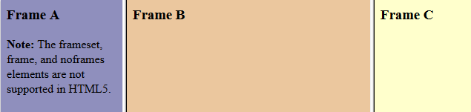
HTML <frame> Tag.
Example
A simple three-framed page:
<frameset cols="25%,50%,25%"> <frame src="frame_a.htm"> <frame src="frame_b.htm"> <frame src="frame_c.htm"> </frameset>
Each <frame> in a <frameset> can have different attributes, such as border, scrolling, the ability to resize, etc.

Slide 51
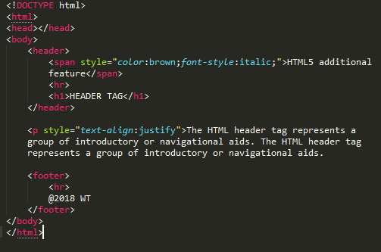
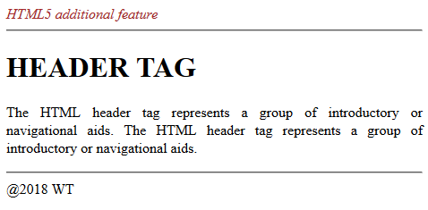
<header> and <footer>
Headers can contain headings, subheadings, version information, navigational controls, etc.
The <header> tag cannot be placed within a <footer>, <address> or another <header> element.

Slide 52
HTML – audio/video/youtube
<audio controls> <source src="horse.ogg" type="audio/ogg"> <source src="horse.mp3" type="audio/mpeg"> </audio>
<video width="320" height="240" controls> <source src="movie.mp4" type="video/mp4"> <source src="movie.ogg" type="video/ogg"> </video>
<iframe width="420" height="315" src="https://www.youtube.com/embed/tgbNymZ7vqY?autoplay=1"> </iframe>

Slide 53
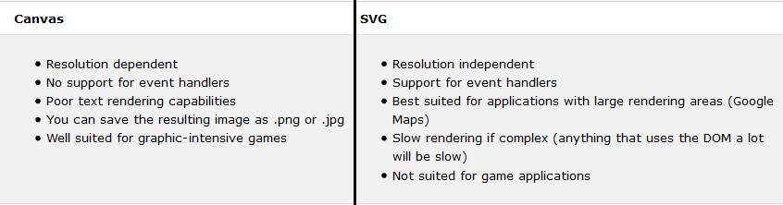
HTML – Graphics
SVG - Scalable Vector Graphics
It is used to define graphics for the Web
It has several methods for drawing paths, boxes, circles, text, and graphic images.
SVG is a language for describing 2D graphics in XML.
Canvas - Canvas draws 2D graphics, on the fly (with a JavaScript).
Example : Generate clock using canvas
https://www.w3schools.com/graphics/canvas_clock_start.asp
Google Maps

Slide 54
HTML – googlemaps
function initMap() {
var test = {lat: 19.0760, lng: 72.8777};
var map = new google.maps.Map(document.getElementById('map'), {
zoom: 10,
center: test
});
var marker = new google.maps.Marker({
position: test,
map: map
});
}
The test variable defines the properties for the map.
The center property specifies where to center the map (using latitude and longitude coordinates).
The zoom property specifies the zoom level for the map (try to experiment with the zoom level).
Add google maps API

Slide 55
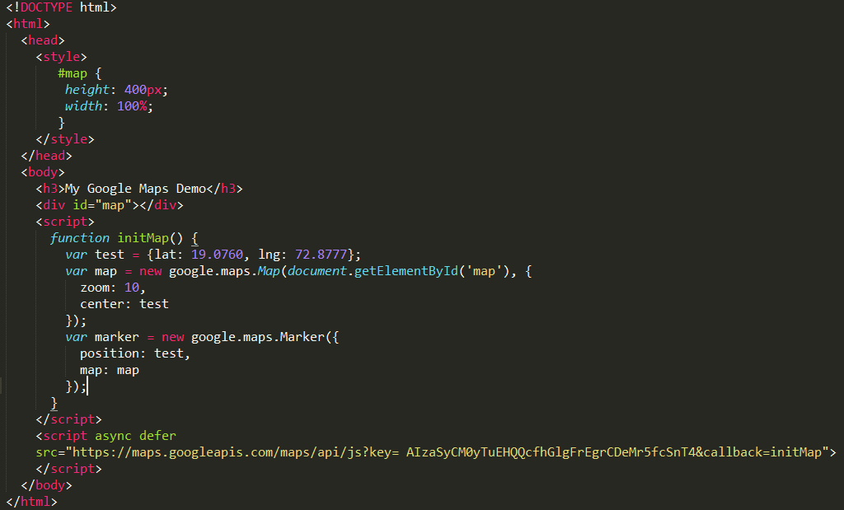
Google map example for Mumbai region

Slide 56
Assignment Title
Design a Form for Company Registration which includes all elements of form tag

Slide 57
Task For Students
Using Appropriate Editor student have to write HTML Script for Company Registration Form as Shown in Sample on Next Slide
Student can add own ideas as per their interest
Form will be only Simple form which will accept data( no database connection)
After clicking Submit Screen should show form submitted successfully

Slide 58
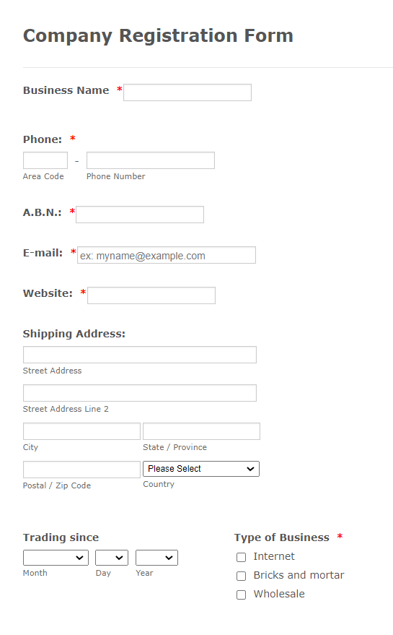
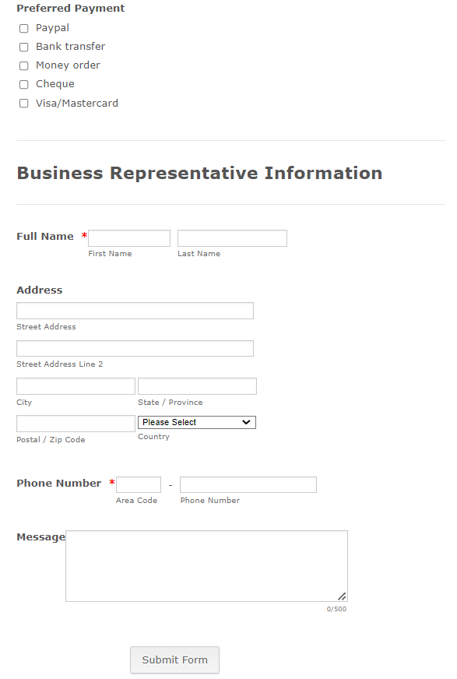

Slide 59
THANK YOU

